Slide 1
Goodbye VMs… Hello Docker

Slide 2
The Challenge
Development
Testing
App Server
Database
Message Queues
Analytics
Monitoring
Cache
Staging
Production

Slide 3
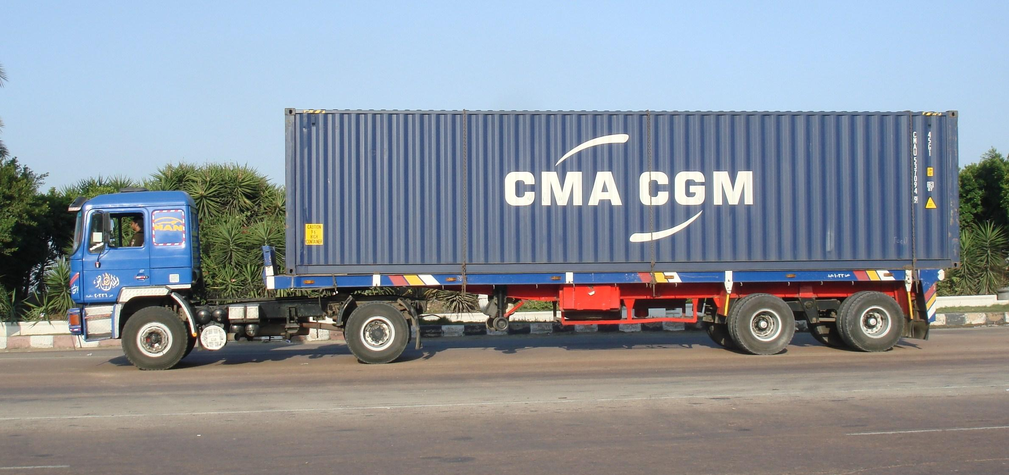
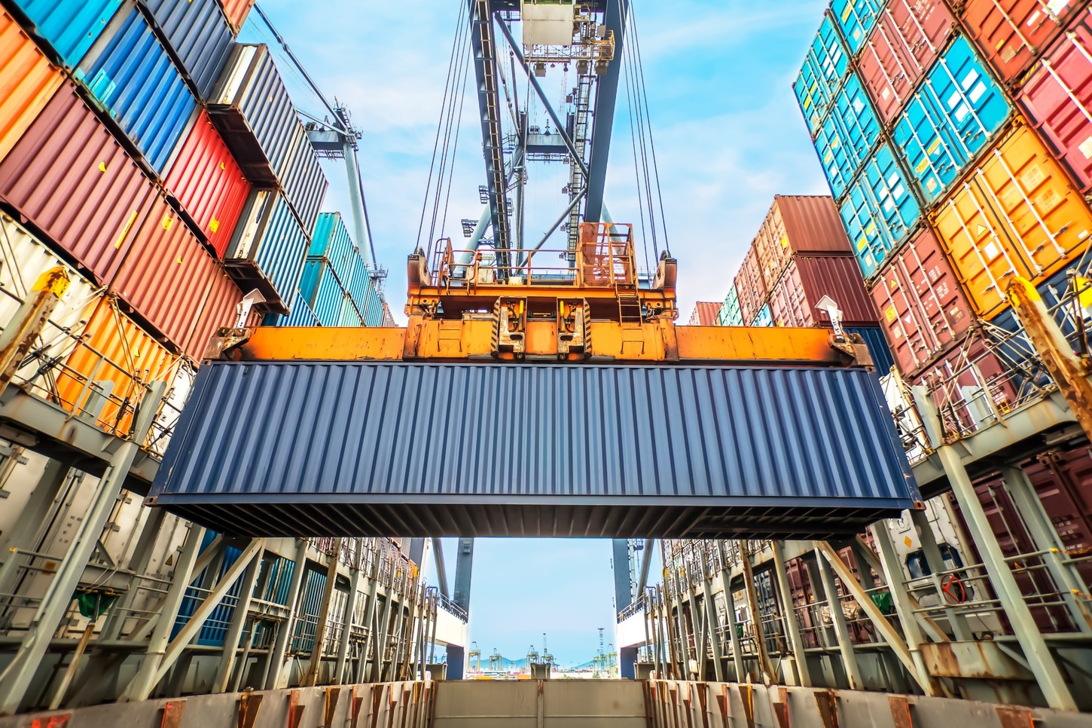
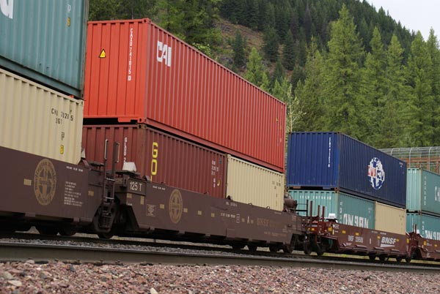
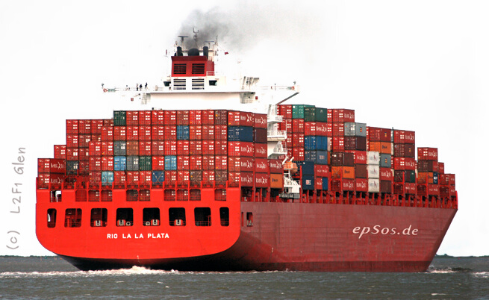


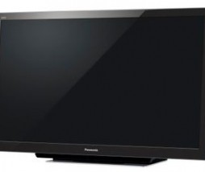
Containers to the Rescue

Slide 4
What is Docker
Portable Runtime Environment
Self-contained
Pre-configured
Isolated
Fully automated
Availability
Linux
Mac OS
Windows
Rasberry Pi

Slide 5
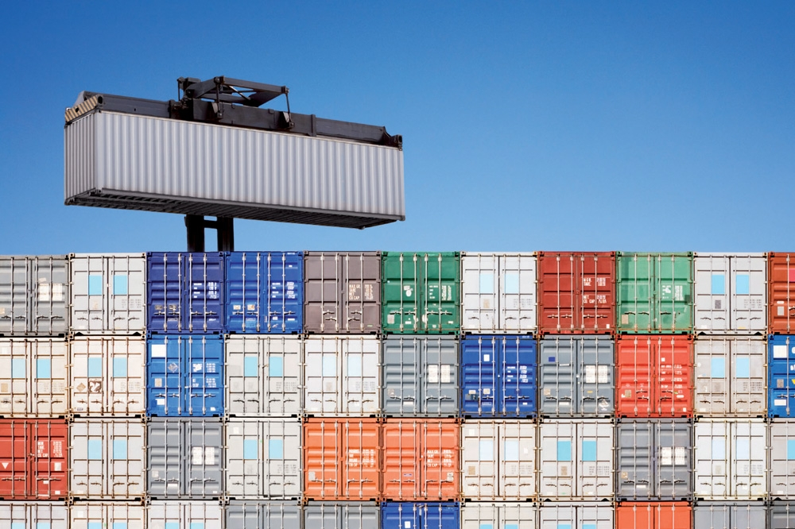
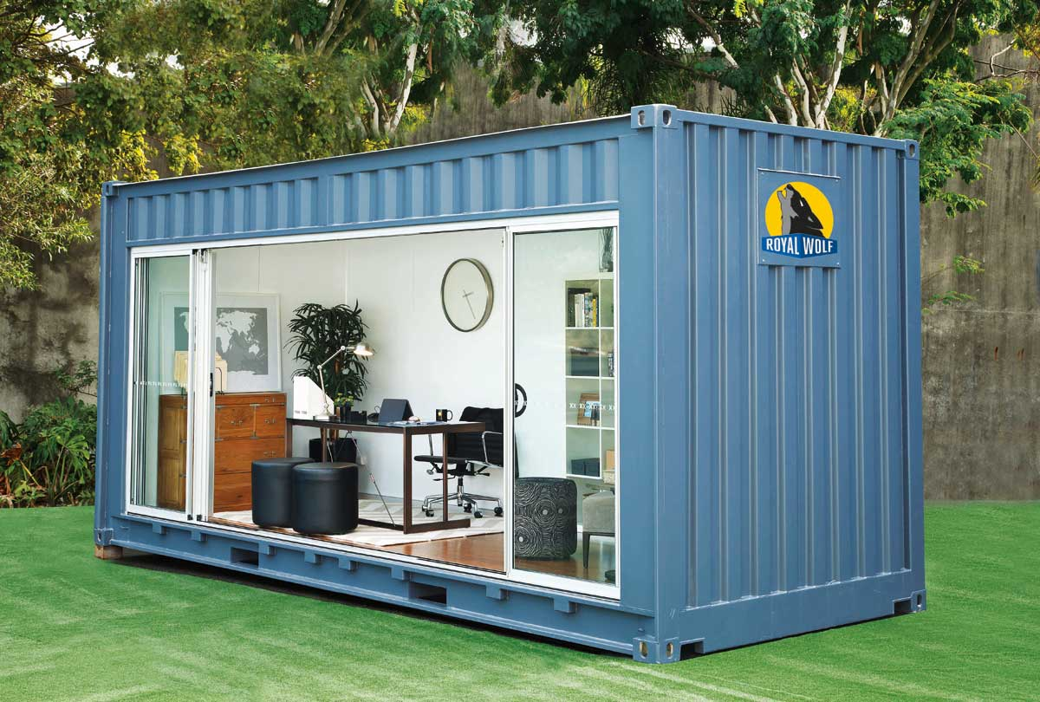
Container Duality
Ops/IT View
Developer View
Notes:
OPS – Move, start, stop, network, monitor, security
Dev – Code Dependencies

Slide 6
Containers vs VMs
App A
App B
App C
Bins/
Libs
Bins/
Libs
Bins/
Libs
Virtual Machine
App A
App B
App C
Docker
Guest OS
Guest OS
Guest OS
Container
Bins/
Libs
Bins/
Libs
Hypervisor
Host OS
Host OS
Server
Server

Slide 7
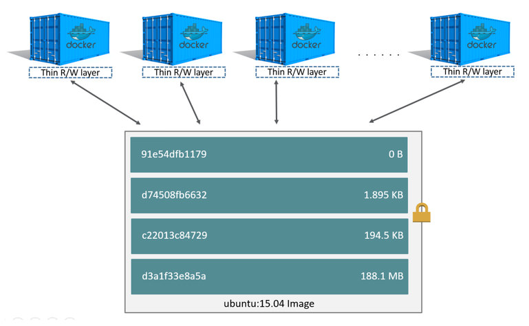
Containers are Layered

Slide 8
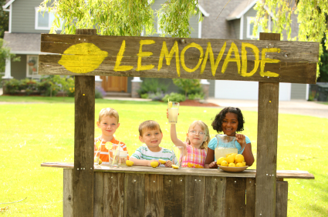

Docker Hub
Docker Images

Slide 9
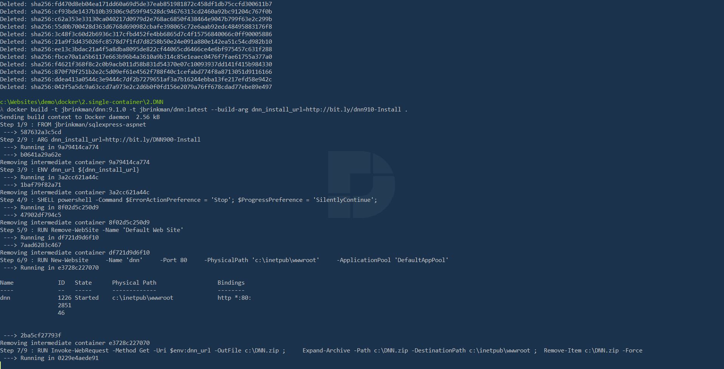
D
E
M
O

Slide 10
Resources
https://github.com/jbrinkman/goodbye-vm-hello-docker
https://docs.docker.com/docker-for-windows/#general
https://blog.sixeyed.com/dockerizing-nerd-dinner-part-1-running-a-legacy-asp-net-app-in-a-windows-container/
https://blog.sixeyed.com/dockerizing-nerd-dinner-part-2-connecting-asp-net-to-sql-server/
https://www.youtube.com/watch?v=i7yoXqlg48M

Slide 11
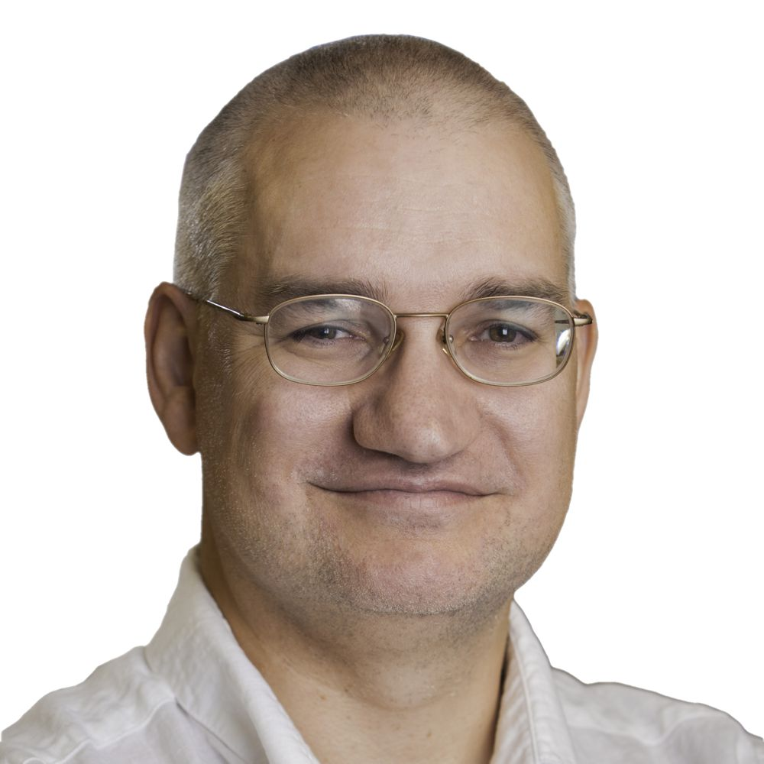


About Me
Joe Brinkman
Co-founder DNN Corp.
@jbrinkman
/joebrinkman

